Slide 1

Topic: Analysing the impact of Exchange Rate fluctuations on major Stock Market Indices
Prepared by: Tanishq Gupta
Applied Econometrics of FX Markets

Slide 2
Introduction
Objective:
To identify the relationship between exchange rates and stock market indices of major countries using Econometric models.
Examine the impact of exchange rate fluctuations on stock market indices and identifying volatility and correlation.
Research Questions:
How do exchange rate fluctuations affect stock market indices?
How do the volatility patterns and correlations between exchange rates and stock indices looks like?
Under different economic regimes, how do these relationships differ?

Slide 3
Motivation & Background of the study
Motivation:
Global market volatility post Covid pandemic
Major geopolitical events like conflicts between countries.
The relationship is still unclear and unexplored
Potential future implications especially in the Modern Trade war era.
Background:
Global financial integration/Globalisation
Currency & stock market dynamics

Slide 4
Literature Review
Chkili et al. (2013):Exchange rate fluctuations do not have impact on stock market returns but changes in stock prices can lead to movements in exchange rate
Model: Markov switching & VAR models
Cenedese et al. (2015): Stock market return of a country cannot be reliable predictor of currency fluctuations.
Model: VAR & Cointegration Analysis.
Zhang et al. (2020):During the global financial crisis,there was stronger correlation between exchange rates and stock markets.
Model: TVP-VAR model
Khan et al. (2020):Both exchange rates and stock markets had higher volatility during COVID-19 pandemic
Model: GARCH for volatility analysis.

Slide 5
Data Description
Data Source (Yahoo Finance, 01/11/2019- 31/10/2024)
Stock market indices:
Germany: DAX
UK: FTSE 100
India: NIFTY 50
Japan: Nikkei 225
US: S&P 100
China: Shanghai Composite Index
Singapore: SGX NIKKEI 225
Foreign exchange rates :
CNY/USD, EUR/USD, GBP/USD , INR/USD , JPY/USD , SGD/USD

Slide 6
Methodology & Models
Augmented Dickey–Fuller test (ADF)
Autoregressive–Moving-Average(ARMA) Model
Autocorrelation & Partial Autocorrelation Function(ACF & PACF) Plots
Dynamic Conditional Correlation(DCC) GARCH model
Vector Autoregression (VAR)
Markov Switching Model
Data analysis implemented using R packages (tidyr, rmgarch, vars, dplyr, readxl,forecast, rugarch, tsDyn, tseries, MSwM)

Slide 7
Expected Outcomes
Understand how geopolitical events influence market volatility and risk aversion.
Influence of past values in the current values.
Evaluating the relationship between Exchange rates and stock market Indices.
Identify patterns and regime shifts in market behavior.
Provide insights for investors, policymakers, and researchers.

Slide 8
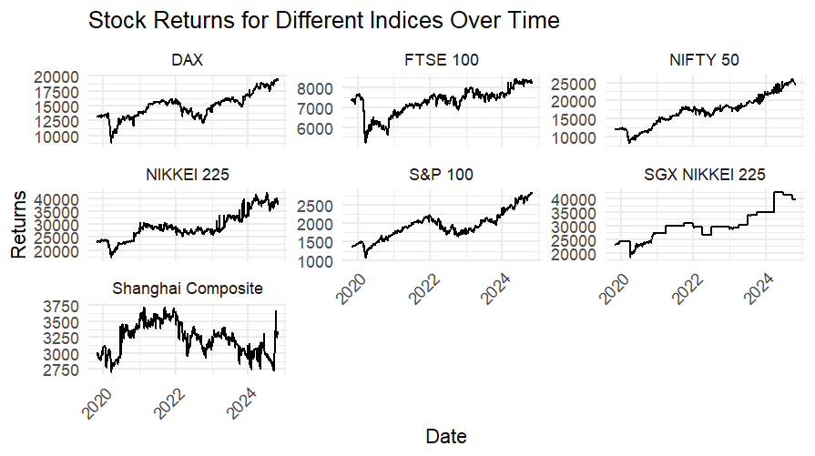
Data results:

Slide 9
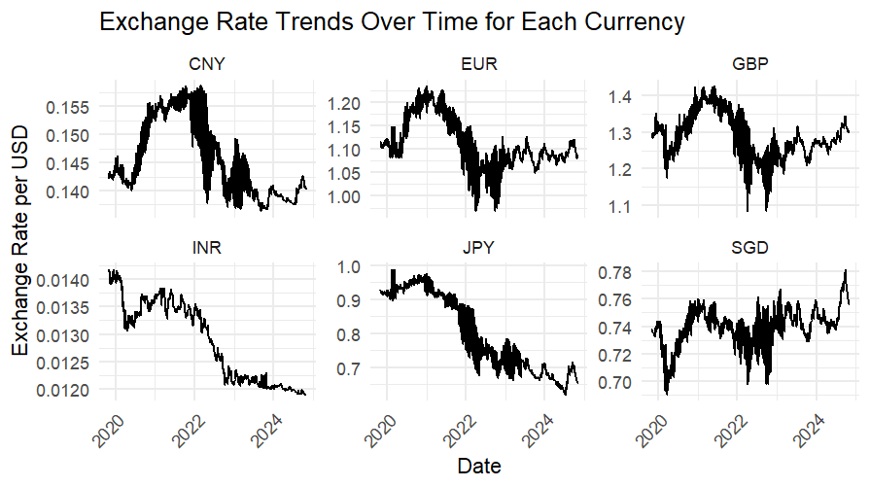
Data results:

Slide 10
Stationarity Analysis- ADF test
Objective: To test for stationarity in time series data, otherwise require log-differencing to achieve stationarity.
Results:
Time series is non-stationary except for FTSE 100 indices with a p-value less than 0.05, indicating it is stationary.
All other indices & exchange rates have p-values greater than 0.05, indicating non-stationarity.
Reason for non-stationarity:
Data might be influenced by deterministic trends, fluctuations, or other external factors like Exogeneous shocks, Geopolitical events, Heteroskedasticity.

Slide 11
ARMA MODEL
Objective: Identifying the best lag structure
Results:
Currencies like JPY, GBP, EUR, and CNY show structured autocorrelation patterns.
Certain currencies & indices like INR, FTSE 100, DAX, & SGX NIKKEI 225 act as a white noise processes with little dependence on past values.
Nikkei 225 and Shanghai Composite exhibit a mild autocorrelation structure.
Further analysis: Using ACF & PACF Plots

Slide 12
ACF & PACF
Objective: to visualize dependencies in the data and guide model selection.
Results:
JPY, GBP, and INR: Significant autocorrelation at early lags suggests strong past dependence.
EUR and SGD: Significant autocorrelation indicates past values influence future values.
CNY: Significant autocorrelation suggests past values impact future exchange rates.
S&P 100, SGX NIKKEI 225, and Shanghai Composite: Significant autocorrelation at early lags indicates past values influence future values.

Slide 13
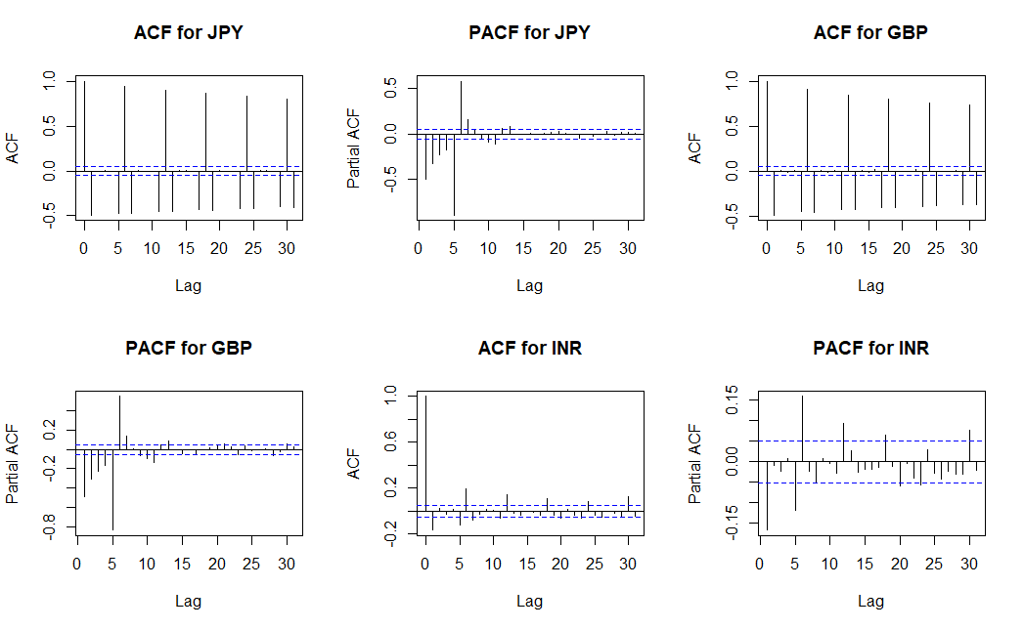
ACF & PACF Plots for JPY, GBP & INR

Slide 14
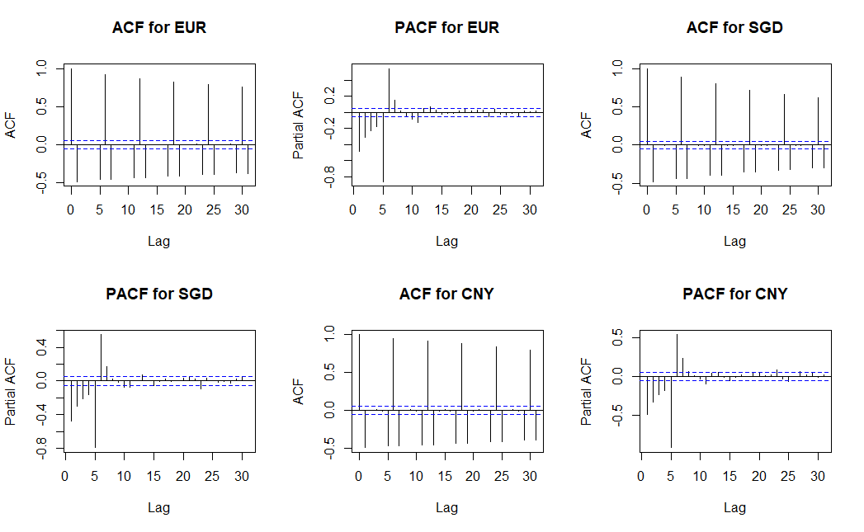
ACF & PACF Plots for EUR,SGD & CNY

Slide 15
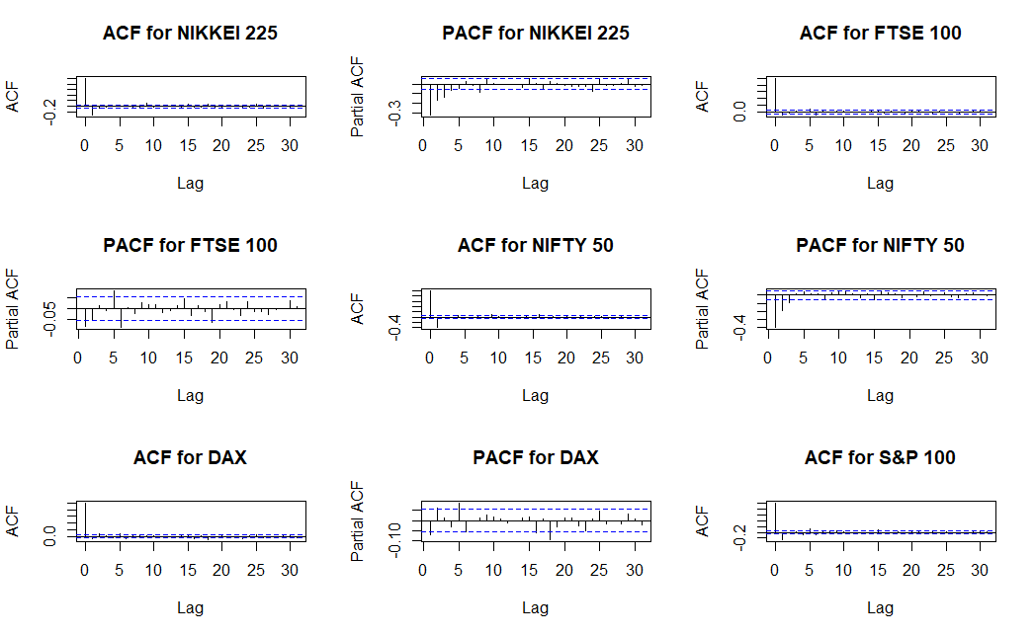
ACF & PACF Plots for NIKKEI 225,FTSE 100,NIFTY50 ,DAX & S&P 100

Slide 16
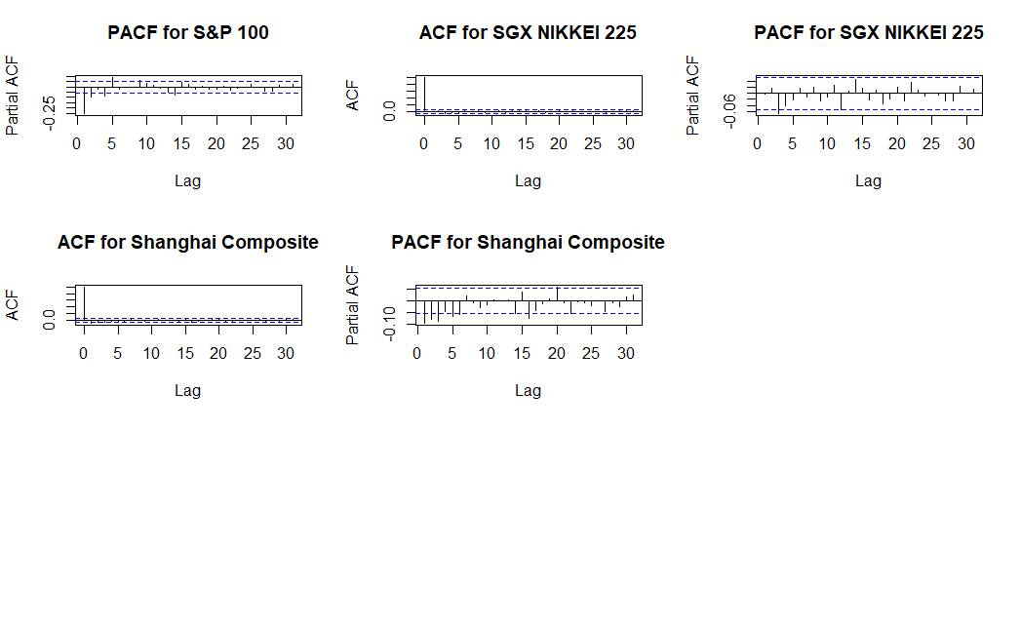
ACF & PACF Plots for S&P 100,SGX NIKKEI 225 & Shanghai Composite

Slide 17
Dynamic Conditional Correlation (DCC) GARCH Model:
Objective: To model time-varying volatility and capture dynamic correlations between data.
Results:
Effectively captures the time-varying correlations
Significant α and β, highly correlated
Strong autoregressive and moving average components in volatility
Investment Implications and Policy Insights

Slide 18
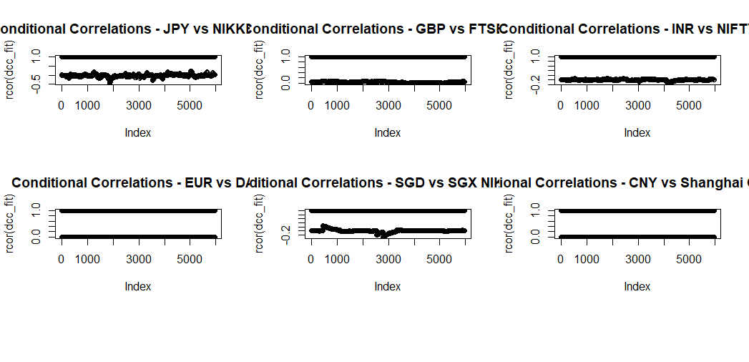
Conditional Correlations Graph

Slide 19
Correlation - Summary Table
Pair | Avg Volatality (Exchange) | Avg Volatility (Stock) | Avg Correlation
JPY vs NIKKEI 225 | 0.0259 | 0.0220 | -0.0255
GBP vs FTSE 100 | 0.0192 | 0.0109 | 0.0358
INR vs NIFTY 50 | 0.0027 | 0.0196 | -0.0019
EUR vs DAX | 0.0178 | 0.0125 | -0.0055
SGD vs SGX NIKKEI 225 | 0.0092 | 0.0071 | 0.0025
CNY vs Shanghai Composite | 0.0130 | 0.0151 | -0.0055

Slide 20
Vector Autoregressive (VAR) MODEL
Objective: Capturing simultaneous modelling of both exchange rates and stock market returns to show mutual influences without assuming causality.
Results:
Shows High likelihood value.
Low correlation
High R² for India & Japan
The currencies are strongly influenced by its past values but not the stock market indices.
Overall dependence differs for each country.

Slide 21
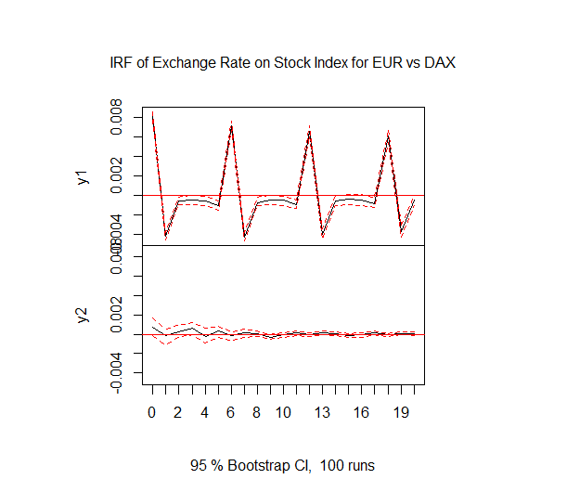
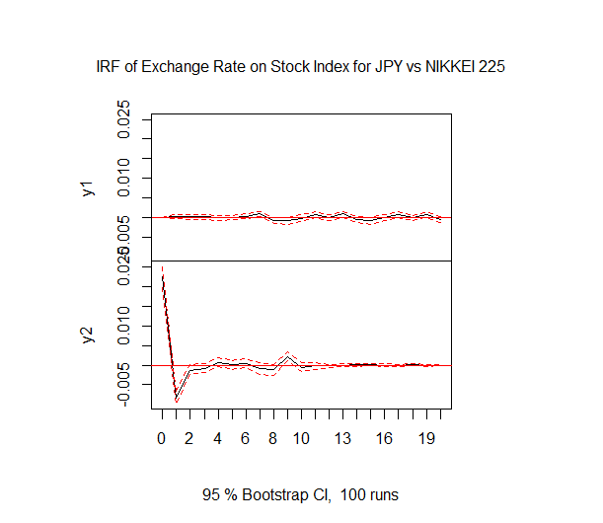
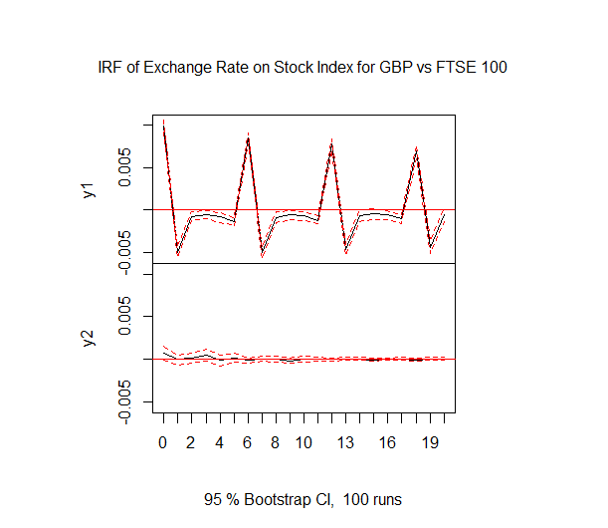
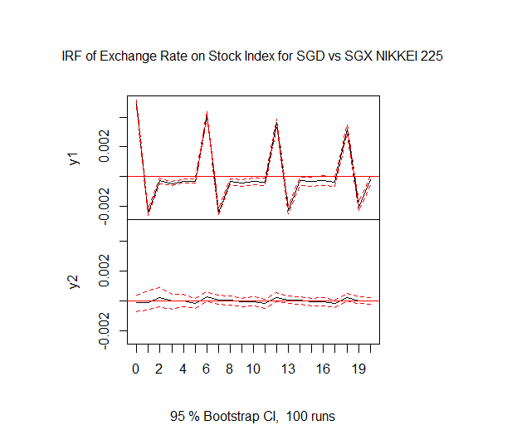
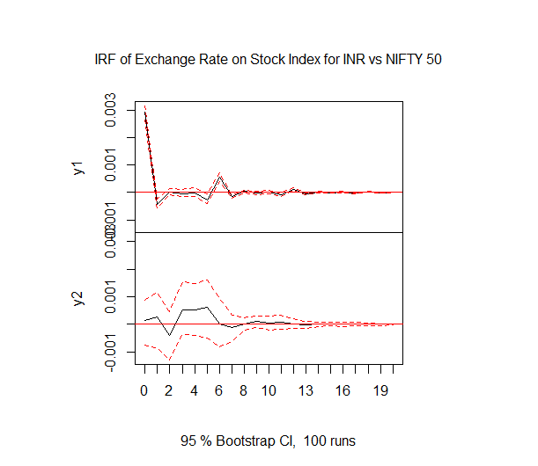
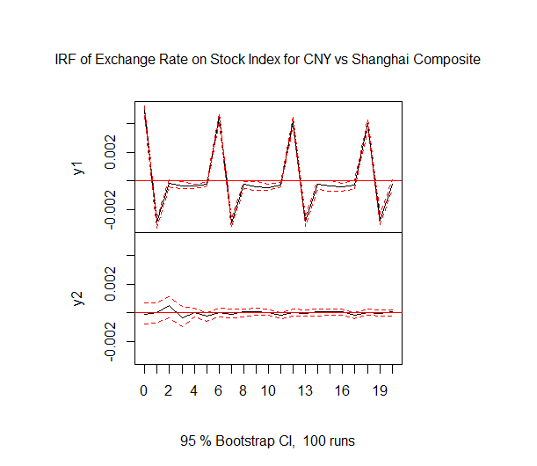

Slide 22
Markov Switching Model
Objective: Analysing how stock markets and exchange rates behave under different market conditions, such as high or low volatility regimes.
Results:
Coefficients are generally weak, and often not statistically significant.
High transition probabilities.
High correlation or zero variance.
Lack of variability and stability.
Modelling challenges.

Slide 23
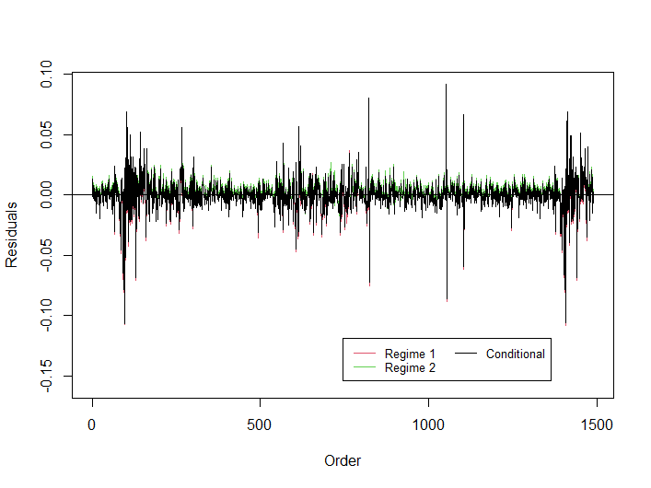
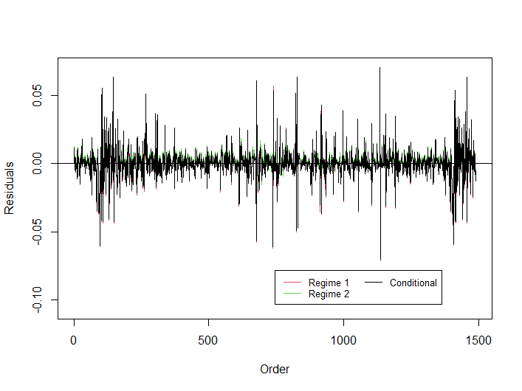
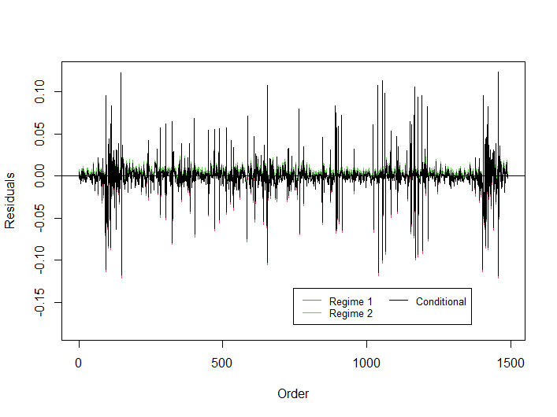
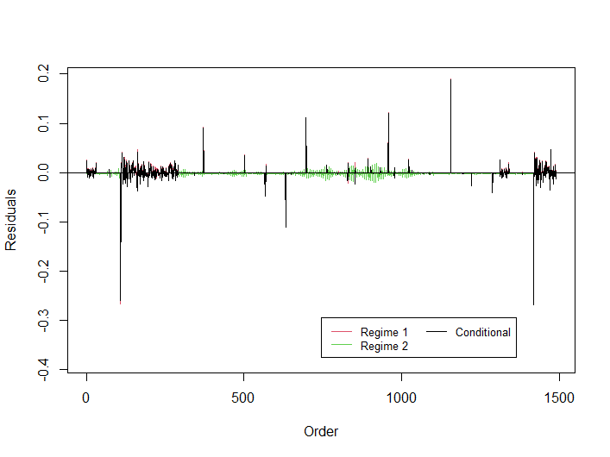
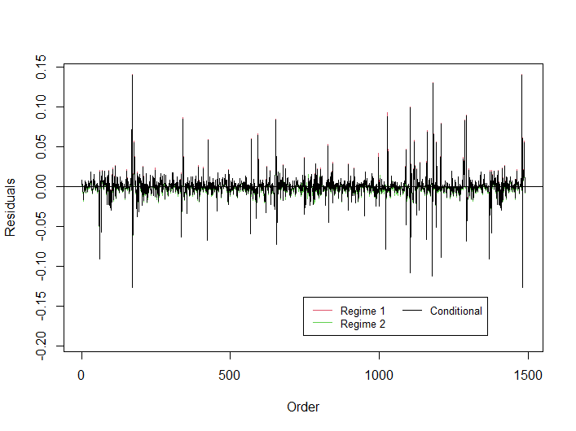
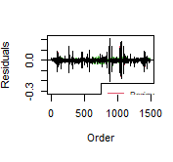
EUR vs DAX
GBP vs FTSE 100
INR vs NIFTY 50
SGD vs SGX NIKKEI 225
CNY vs Shanghai Composite
JPY vs Nikkei 225

Slide 24
Findings/Summary:
Currency-Market Linkages: INR-NIFTY 50 and SGD-SGX
Some pairs (e.g., CNY-Shanghai Composite ) exhibit weak interdependence.
Effects of shocks are generally temporary and stabilize over time.
Regional events and conditions drive time varying correlations.
Most currency-stock pairs exhibit regime shifts, while some, like Pound/FTSE 100 or EUR-DAX, show greater stability.

Slide 25
Key Takeaways & Future Research
Key Takeaways:
Empirical Evidence is Mixed.
Direction of Causality and Volatility.
Modelling Challenges
Emerging Markets vs. Developed Markets
Future Research:
Incorporating additional economic variables like Interest rates, etc.
Exploring nonlinear models or alternative regime-switching models for robustness.
Long-Term Structural Changes, Behavioural Finance factors.

Slide 26
References
Cenedese, G. et al. (2015) ‘What do stock markets tell us about exchange rates? ’, Review of Finance, 20(3), pp. 1045–1080. doi:10.1093/rof/rfv032.
Chkili, W. and Nguyen, D.K. (2014) ‘Exchange rate movements and stock market returns in a regime-switching environment: Evidence for BRICS countries’, Research in International Business and Finance, 31, pp. 46–56. doi:10.1016/j.ribaf.2013.11.007.
Huang, Q., Wang, X. and Zhang, S. (2021) ‘The effects of exchange rate fluctuations on the stock market and the affecting mechanisms: Evidence from BRICS countries’, The North American Journal of Economics and Finance, 56, p. 101340. doi:10.1016/j.najef.2020.101340.
KHAN, K. et al. (2020) ‘The impact of covid-19 pandemic on stock markets: An empirical analysis of world major stock indices’, The Journal of Asian Finance, Economics and Business, 7(7), pp. 463–474. doi:10.13106/jafeb.2020.vol7.no7.463.
Sosa, M. (2018) ‘Dynamic linkages between stock market and exchange rate in MILA countries: A Markov regime switching approach (2003-2016)’, Análisis Económico, 33(83), pp. 57–74. doi:10.24275/uam/azc/dcsh/ae/2018v33n83/sosa.

Slide 27
THANK YOU!

